Slide 1
Gray Dawes group
Understanding Your Value
11th Aug 2020

Slide 2
Introduction
Who are we?
Why we are here today?
Session Structure – short presentation, Q&A
2 sessions – linked – understand your value then market it!

Slide 3
Understanding your value
Identify Your Skills
Identify your Career Goals
Transferring Your Skills to a New Industry
Your CV: Experience based V Skills based

Slide 4
Identify your skills
Starting point? Your JD
Identify hard and soft skills
Look at your performance reviews
Ask other people for feedback
Check out job postings
https://nationalcareers.service.gov.uk/skills-assessment

Slide 5
Identify your career goals
Just need to get any job?
Don’t undervalue yourself
Is this an opportunity to think outside the box?
Holistic approach

Slide 6
Transferring your skills
Our stories
What are transferable skills?
How to identify yours?
Which industries are recruiting?
Where can you use your skills?

Slide 7
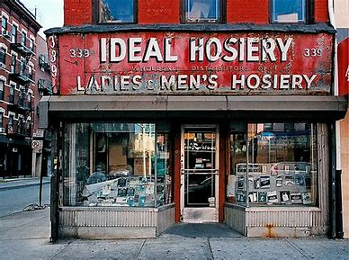
YOUR CV – Shop Window

Slide 8
YOUR CV – Shop Window

Slide 9
Your CV (s)
Examples of Experience V Skills
Tailoring
Top Tips
What did you do in Lockdown?

Slide 10
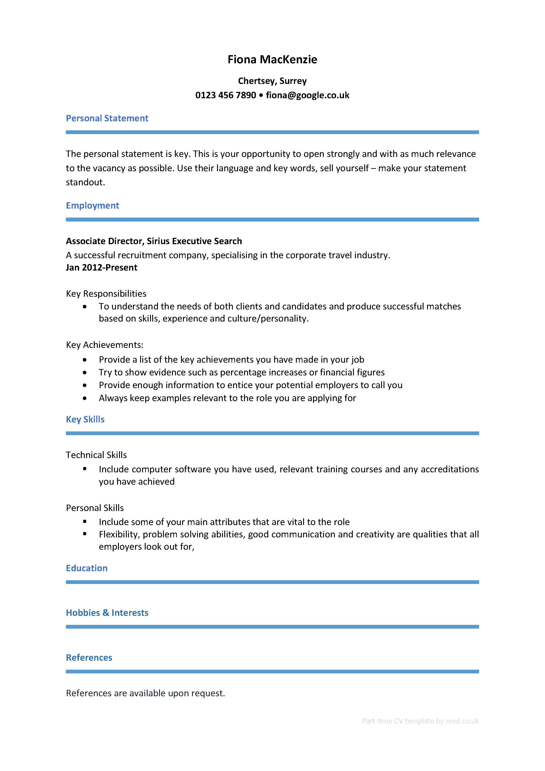
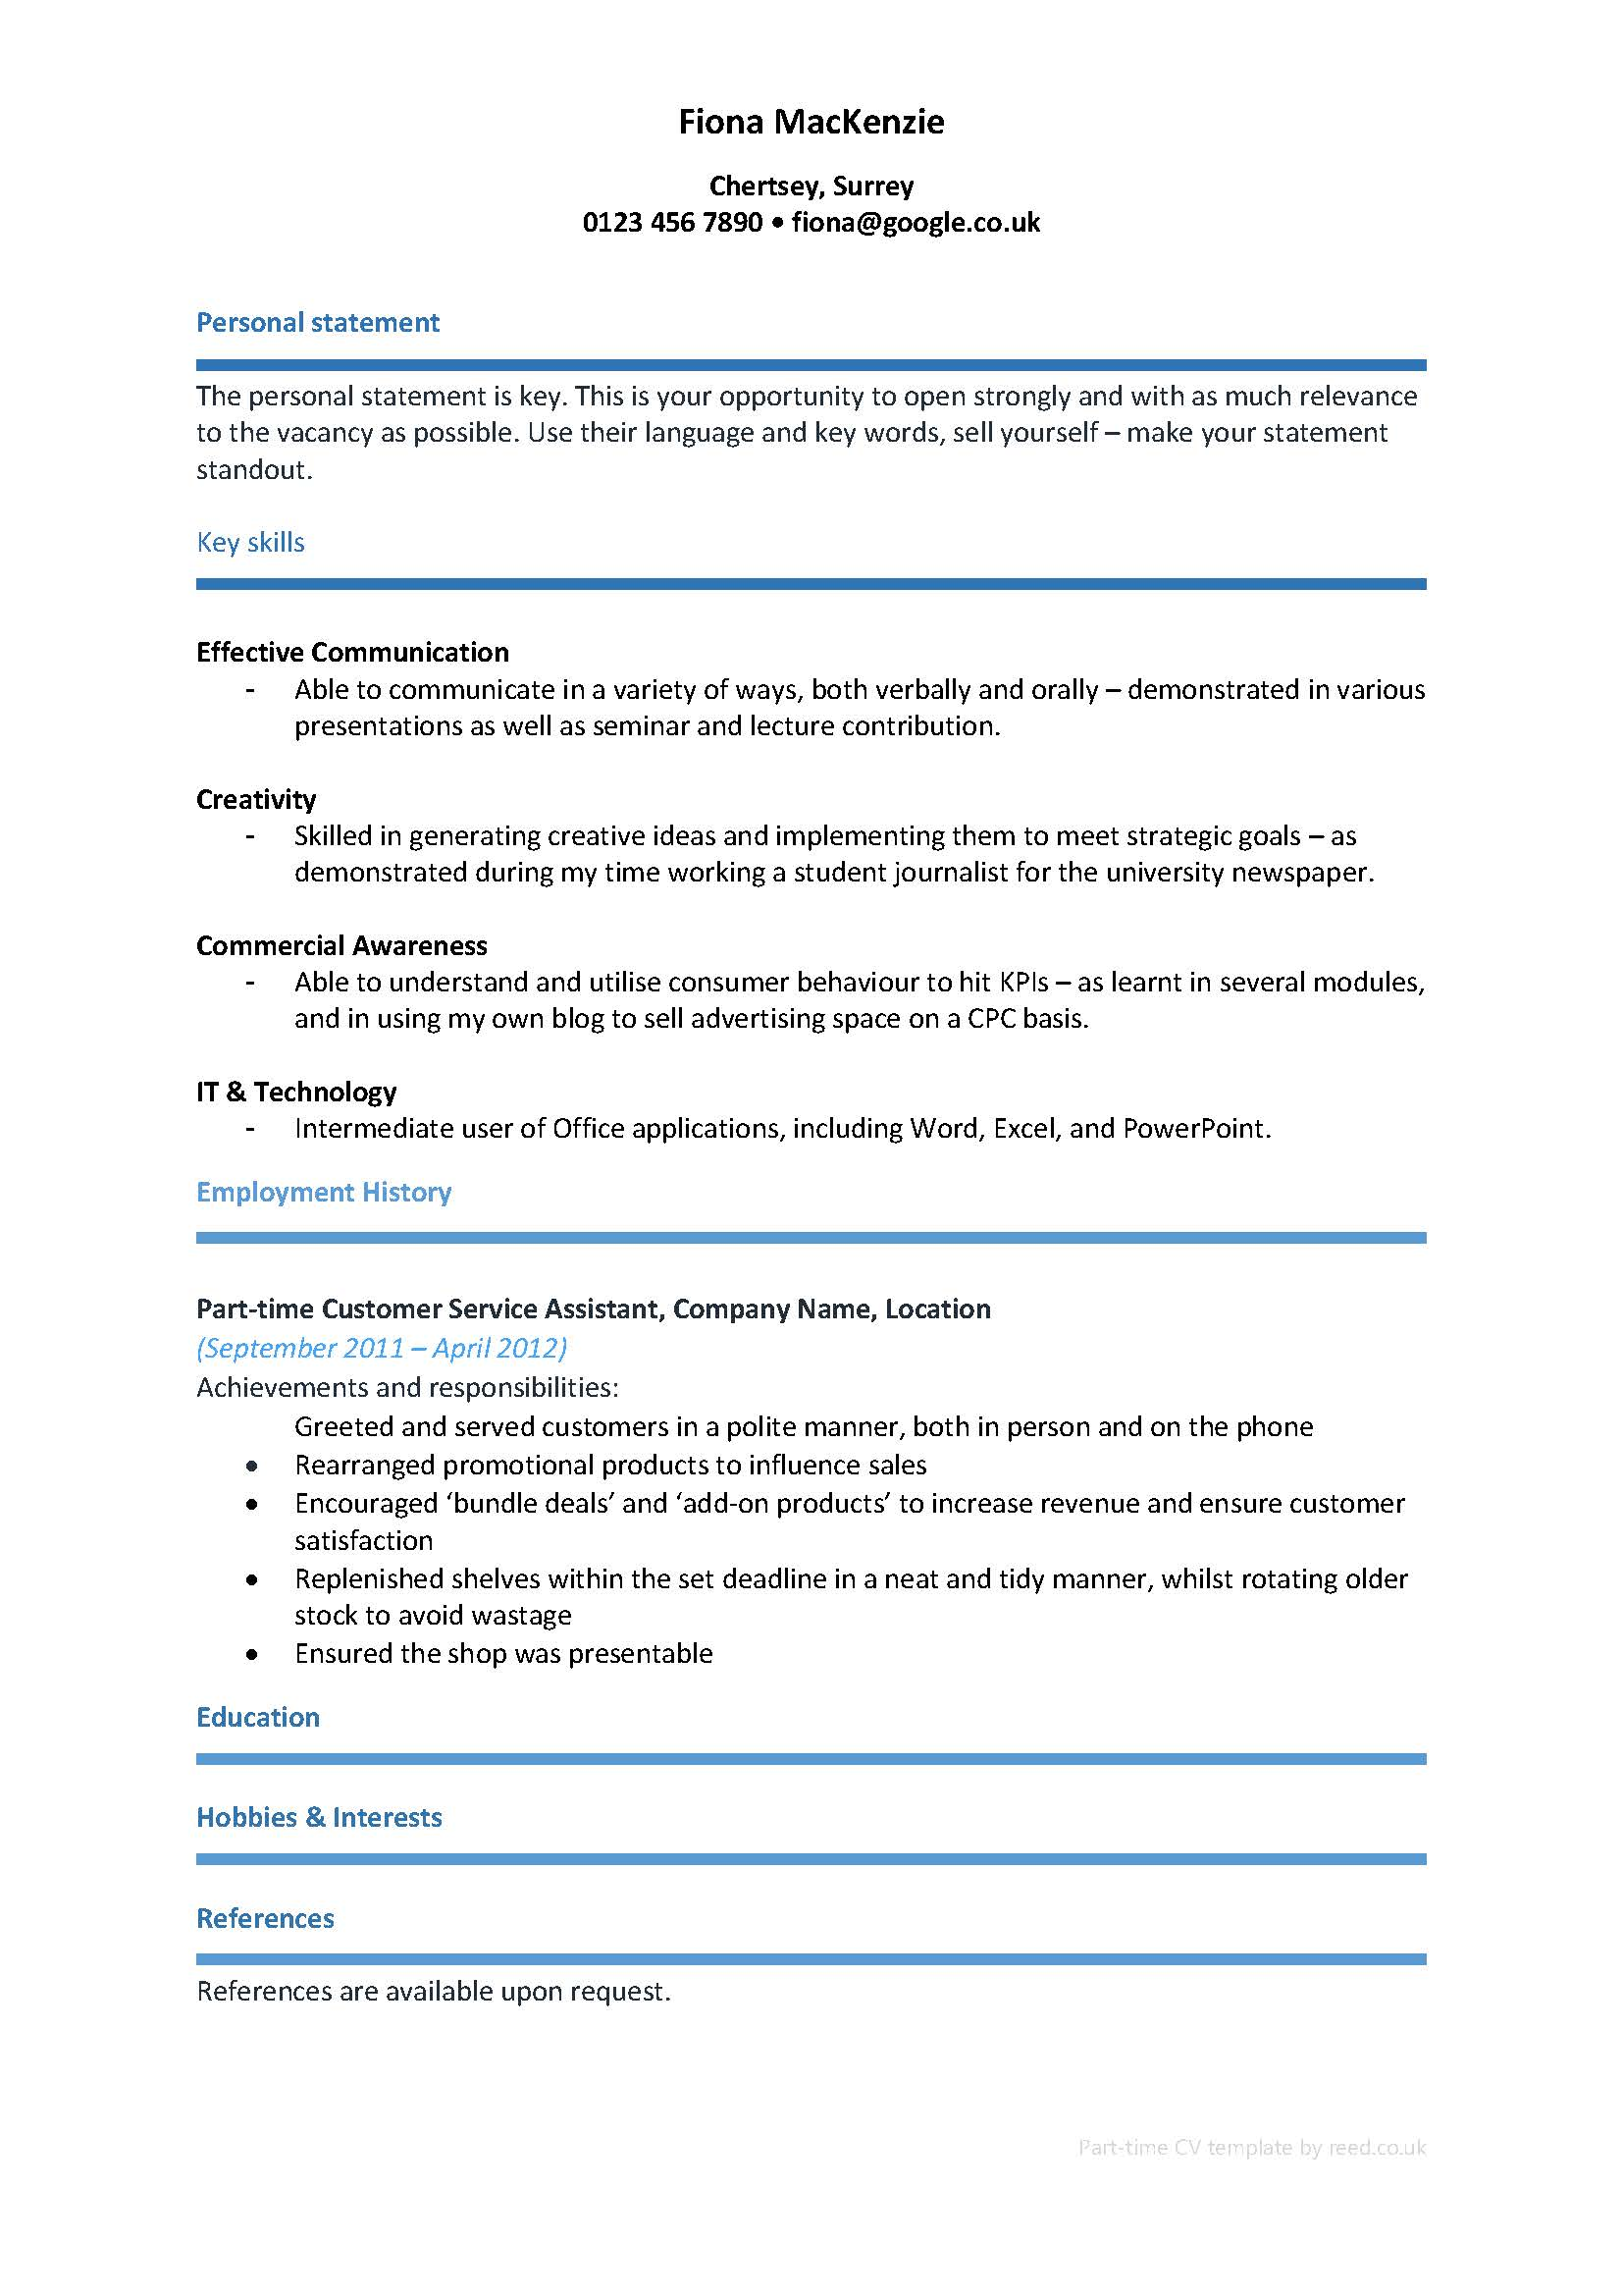
Experience CV V Skills CV
uploading software

Slide 11
Tailoring
Invest your time
Research recruiting company: Identify the language; culture; values; any contacts
Understand what they are looking for
Adapt your CV to fit – honestly
Automated CV scanning – make sure you pass!
Cover letter

Slide 12
COVER LETTER
Company and Job Research – how do you fit the bill?
Format: well-presented; concise; to-the-point; easy to read font and nothing fancy; half a side of A4 (or one page maximum); humour?
Personalise – find out the name of who to send it to.
Structure:
Opening the letter – Why are you getting in touch?
Second paragraph – Why are you suitable for the job?
Third paragraph – What can you do for the company?
Fourth paragraph – Reiterate your interest and why you’re right for the job. Say you’d like to meet.
Closing the letter - ‘Yours sincerely’ (name) or ‘Yours faithfully’ (no name) followed by your name.

Slide 13
1st impression – 20 seconds
Two pages – key responsibilities and achievements (not your JD!)
Consistent font and type size
No photo
Current contact details & professional email address
Logical order, current role backwards
Avoid travel jargon for non-travel roles
Beware AI
Be consistent with punctuation including capital letters and spacing
Minimal formatting – beware uploading software
Explain any gaps – be honest
Tailor CV to the role
Include required skills and qualifications
Hobbies/interests/volunteering
Spellcheck – read and re-read again!
Take pride in it!

Slide 14
What I did in lockdown?
Usual job? Different job?
Gained any new skills? Online training, reading, volunteering?
Family commitments?
Be ready to answer this question – honestly
Unprecedented times: No stigma; Be open

Slide 15
Our industry will bounce back!
Your path may not be perfect but…..
See it as an opportunity
Have a positive mindset
Be ready & understand your value
info@sirius-cv.com • +44 (0)1932 562007 • www.sirius-cv.com

